Slide 1
ROB 542 Actuator Dynamics Task Analysis
Ramsey Tachella
Huanchi Cao
Chirag Shah

Slide 2
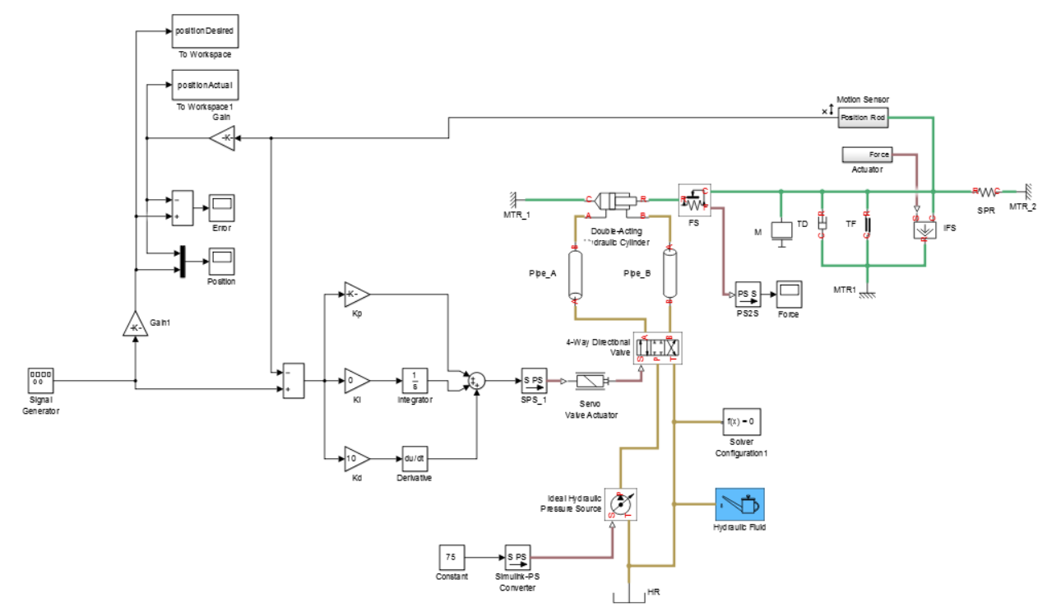
Model: Hydraulic Crane

Slide 3
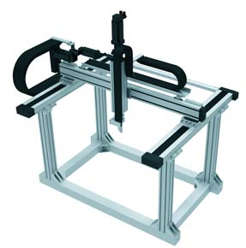
Position Control
Pick and Place:
Single DOF
Frequency: 3 Hz
Mass: 10 kg

Slide 4
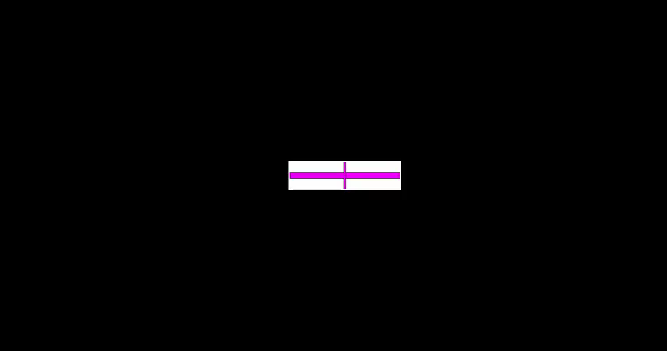
Position Control

Slide 5
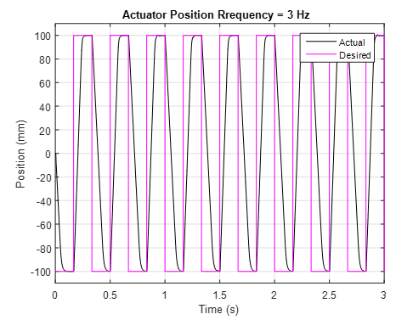
Pick and Place

Slide 6
Position Control

Slide 7

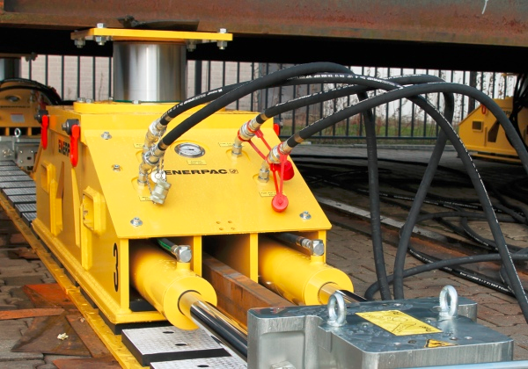
Force Control
Moving with a constant force given outside disturbance
Disturbance: sine wave = 100*sin(10*t)
Mass: 500 Kg
Desired force: 20 N

Slide 8
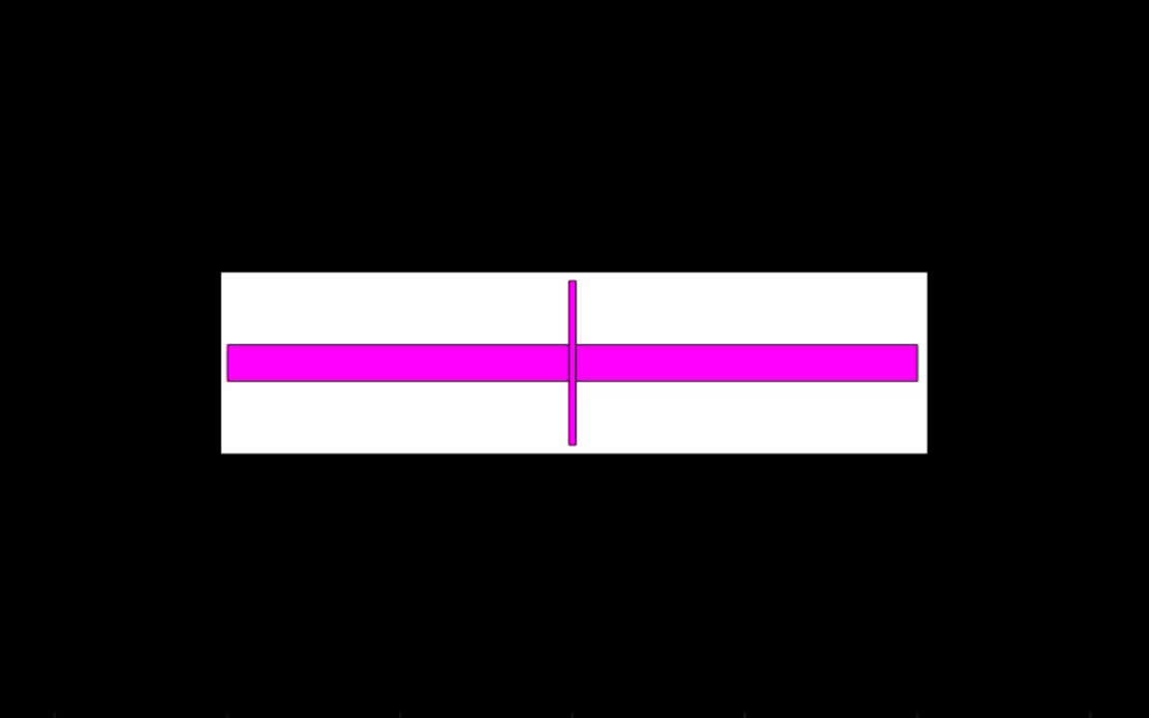
Force Control

Slide 9
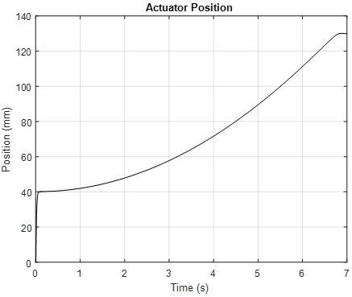
Force Control

Slide 10
Force Control

Slide 11
Thank You

